Slide 1
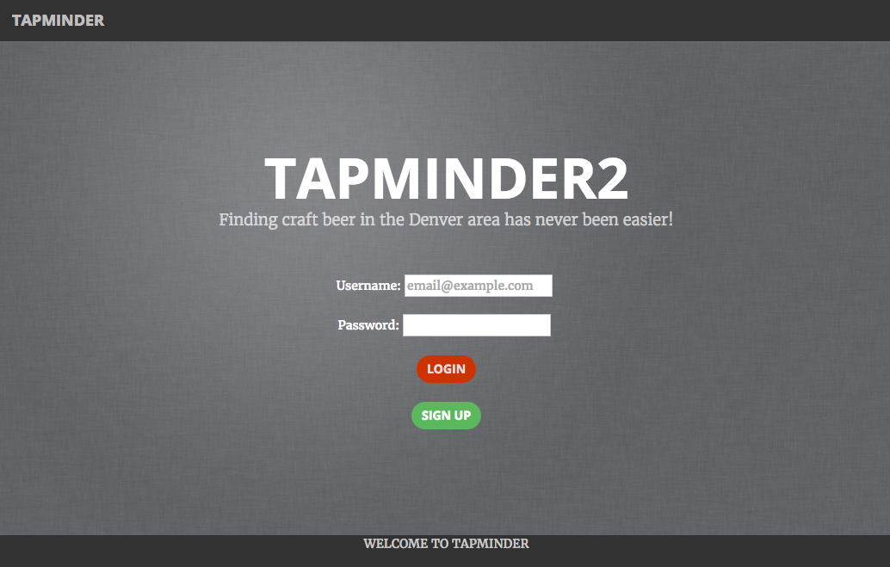
Team
Alex Peterson
Angel Rivera Moreira
Chad Arroyo

Slide 2

Contents
Problem Statement
Customer Dynamics
Overview
Database Schema
Methods and Permissions
Highlights from Code Samples
Stretch Goals
Conclusion

Slide 3

Problem Statement
Customers just don’t know
While the Denver Microbrewery market continues to brew some of the finest beer this world has ever seen, the constant beer innovation, turnover of seasonals and varietals, plus new market entrants has overwhelmed customers taste buds and impacted their ability to understand and experience the local microbrewing landscape.

Slide 4
Customer Dynamics
Giving power back to the people
Locate
Locate
Discover
Share
Local microbreweries
Craft beer
Their beer experience
Unlocking potential of craft beers in the local area

Slide 5
Overview
Finding craft beer should be easier
TapMinder will allow users to do the following:
Discover microbreweries in their local area
Filter and sort through craft beers
Rate and review local beers
Provide microbrewers a direct channel to their customers
Notes:
Location is fundamental to online and offline interaction, especially when sourcing on demand labor
Current way of doing business is not efficiently bridging the gap between the digital and physical world
Missed opportunities, lost revenue, are still common occurrences

Slide 6
Demo Time

Slide 7
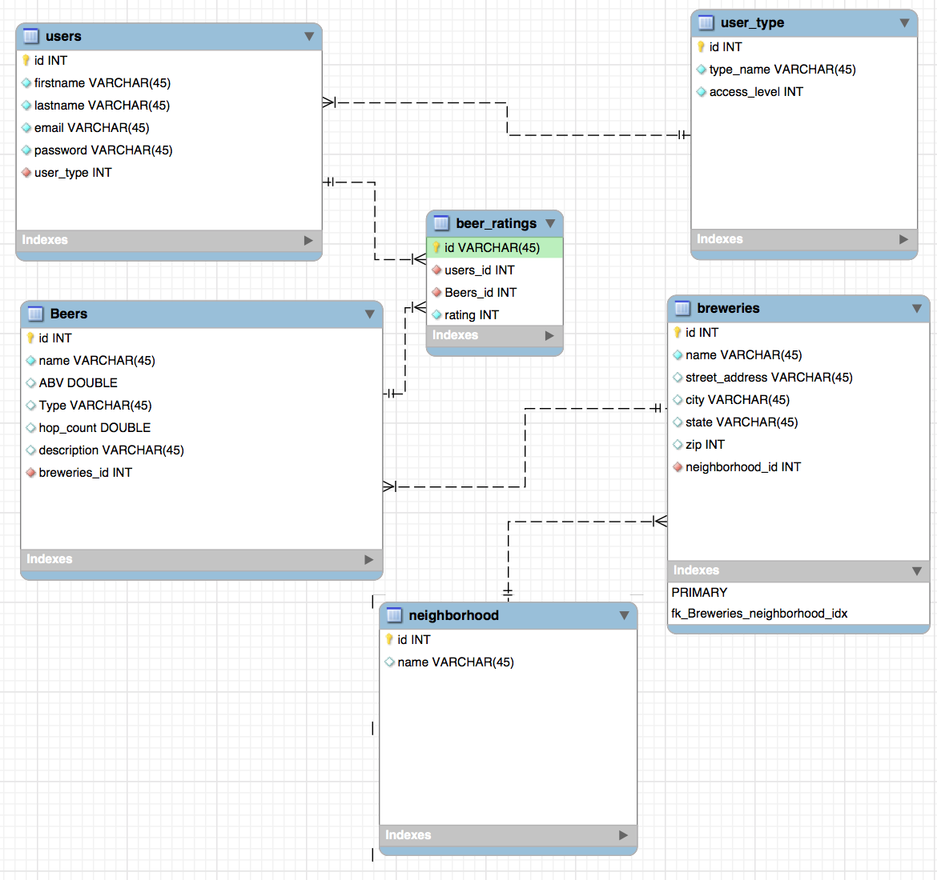
Database Schema
The data is the answer

Slide 8
Methods and Permissions
Interact with the db and control access
User Methods
Create/Add User
Modify/Update User
Delete Standard User*
Delete Moderator*
Brewery Methods
Create/Add Brewery
Update/Modify Brewery
Delete Brewery
Standard User
Moderator
Admin
Beer Methods
Create/Add Beer
Update/Modify Beer
Delete Beer
Rating Methods
Create/Add Rating
Update/Modify Rating
Delete Rating*
Search Methods
Find Users
Find Beer
Find Brewery
Initialization Methods
Init
Init Login
User Authentication

Slide 9
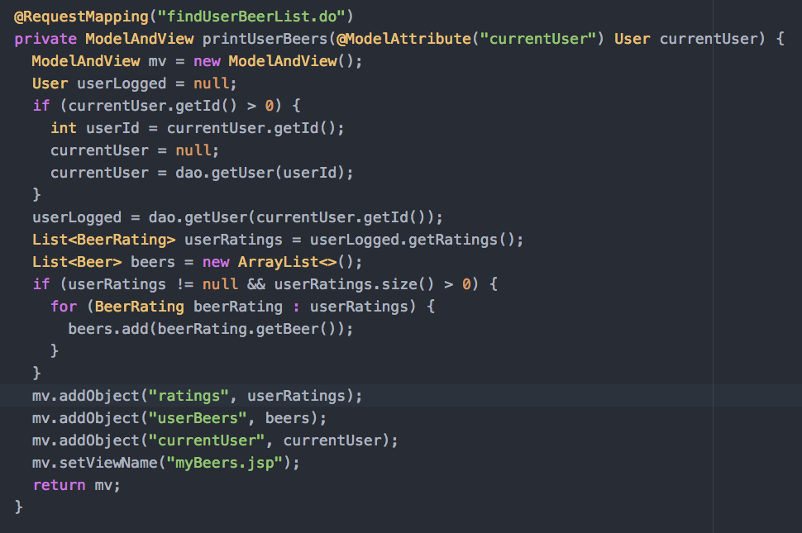
Object Entity Update Challenge
Connecting a User Entity Attribute with the Database
Situation: Following a user deleting a beer rating no change would occur to the User Profile
Diagnosis: The database would show the deletion, but the change would not save to the User Entity List for rating
Solution: By resetting the logged in user to null and then calling the DAO to relogin the User Object Entity Data refreshes and there is synchronization between the user object entity and the database relationship

Slide 10
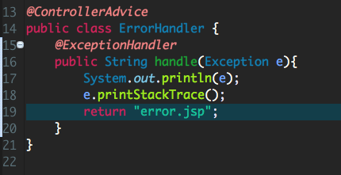
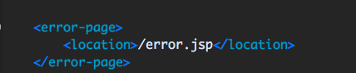
User Error Handling
Don’t let the #404 confuse your user
Situation: User engages with the WebApp and breaks a standard process or internal java code exception they will see 404 exception or other page
Diagnosis: This is generally a bad way to provide WebApp usability and needs resolution
Solution: Implement an exception handler that identifies when an error has been triggered and directed them to a beautifully formatted error.jsp page

Slide 11
Next Step Builds
These are in the development queue
Implement automated database update methods (e.g. using brewerydb api)
Connect better pictures with beer items in the database
Enable users update their own account
Alter workflows for enhanced usability
Search by multiple parameters on one form
Continue standard debugging and beta-testing

Slide 12
Stretch Goals
If we only had more time
Implement user profile pictures
Integrate login with Facebook, Google+, and or Twitter logins
Present mapping interface with microbrewery profiles
Create social media share functionality
Implement gamification workflows

Slide 13
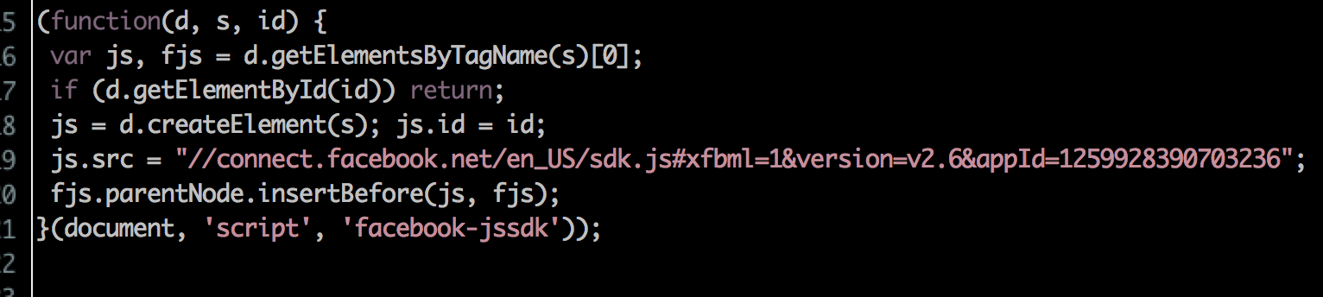
Integrating with Facebook
Enabling easy login and social engagement
Situation: Facebook login credentials are not yet connected with the TapMinder WebApp
Status: Facebook scripts have been implemented within our WebApp and Facebook API calls are operational
Solution: Continue to build out AJAX connection with Facebook API call use attributes and use to create a logged in user that can successfully log out of the TapMinder WebApp

Slide 14
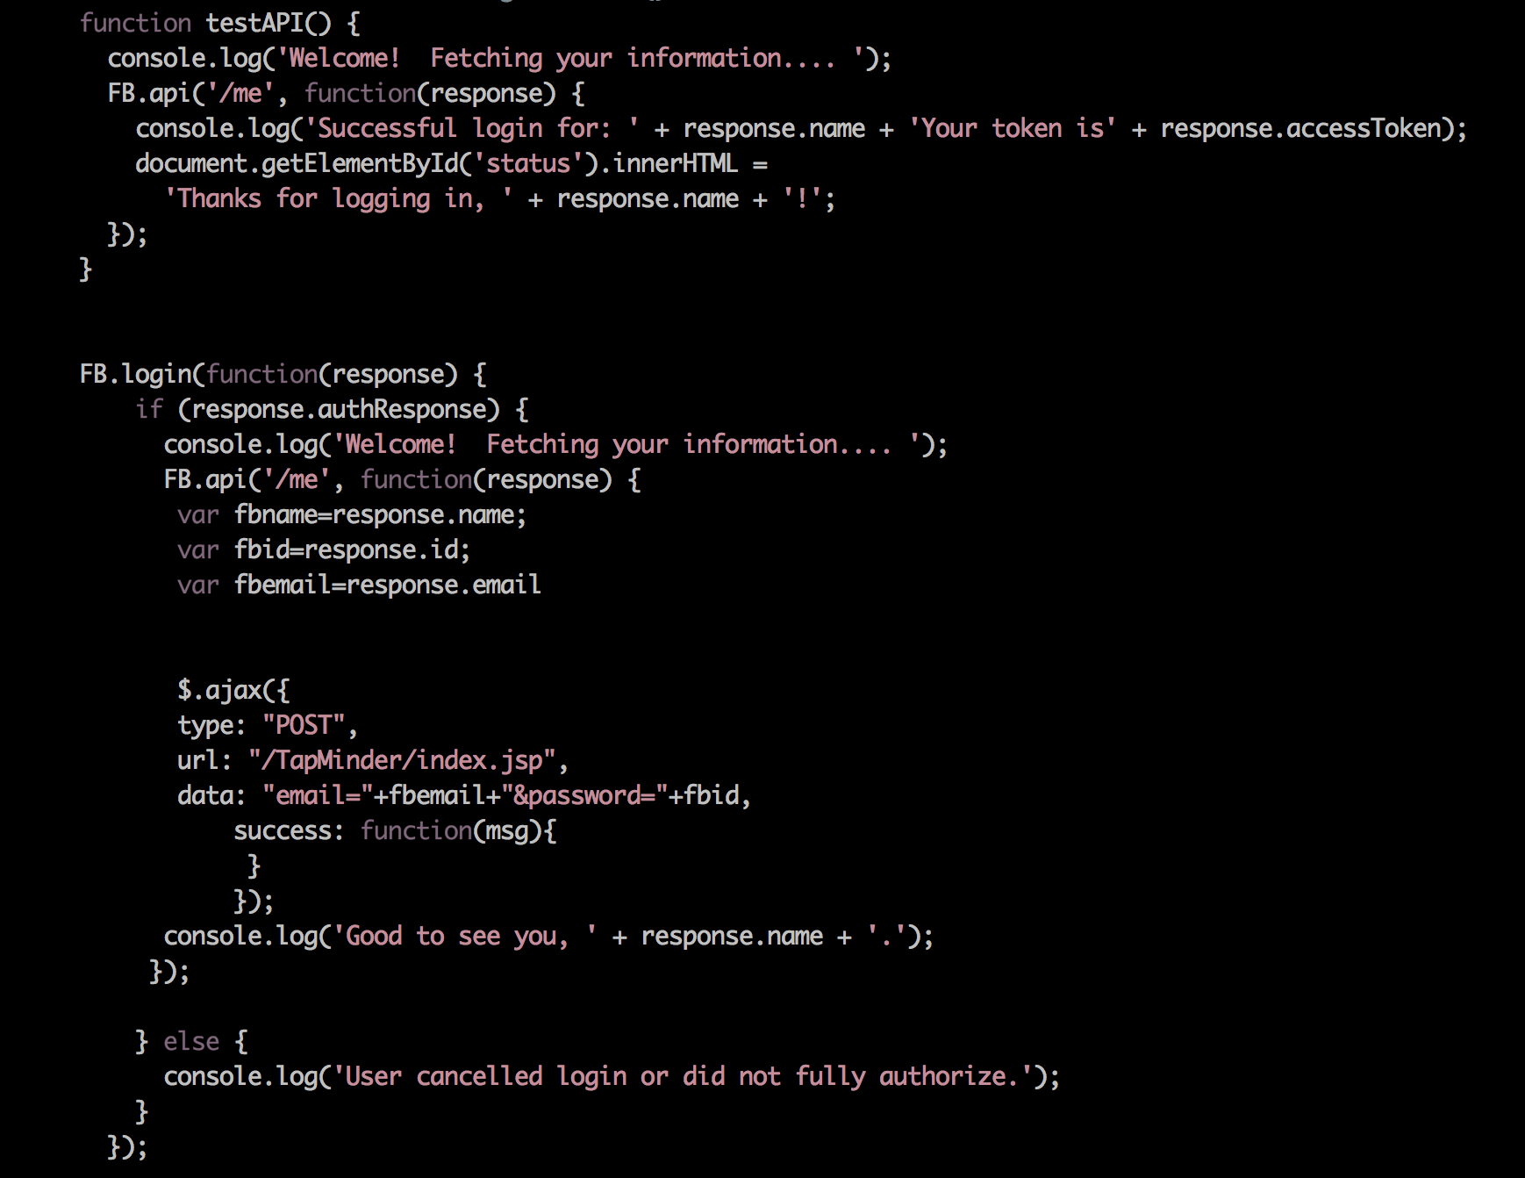
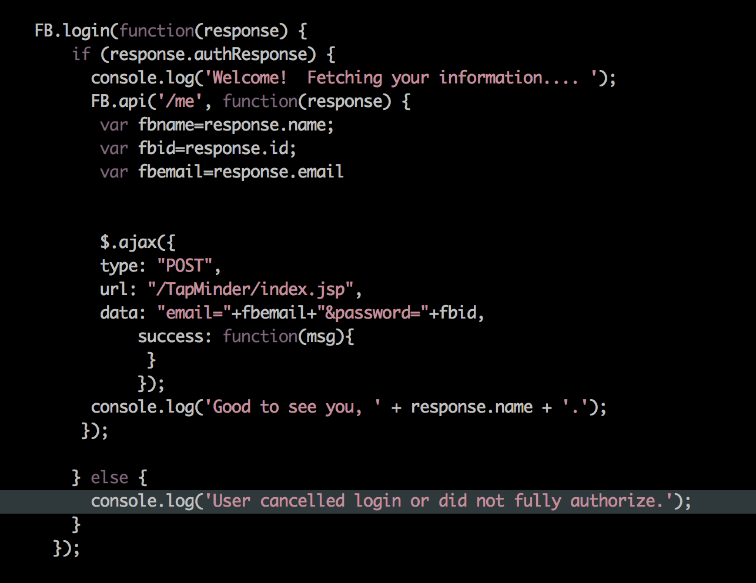
Integrating with Facebook Part II
Enabling easy login and social engagement

Slide 15
Conclusion
Providing Great value to the local community to be able to share knowledge and promote awareness of beer
Technical Lessons Learned:
Designed, built and deployed highly usable CRUD database WebApp
Applied lessons learned for JPA, MySQL, & JPQL
Experienced and thrived in an Agile programming environment

Slide 16

Questions

Slide 17
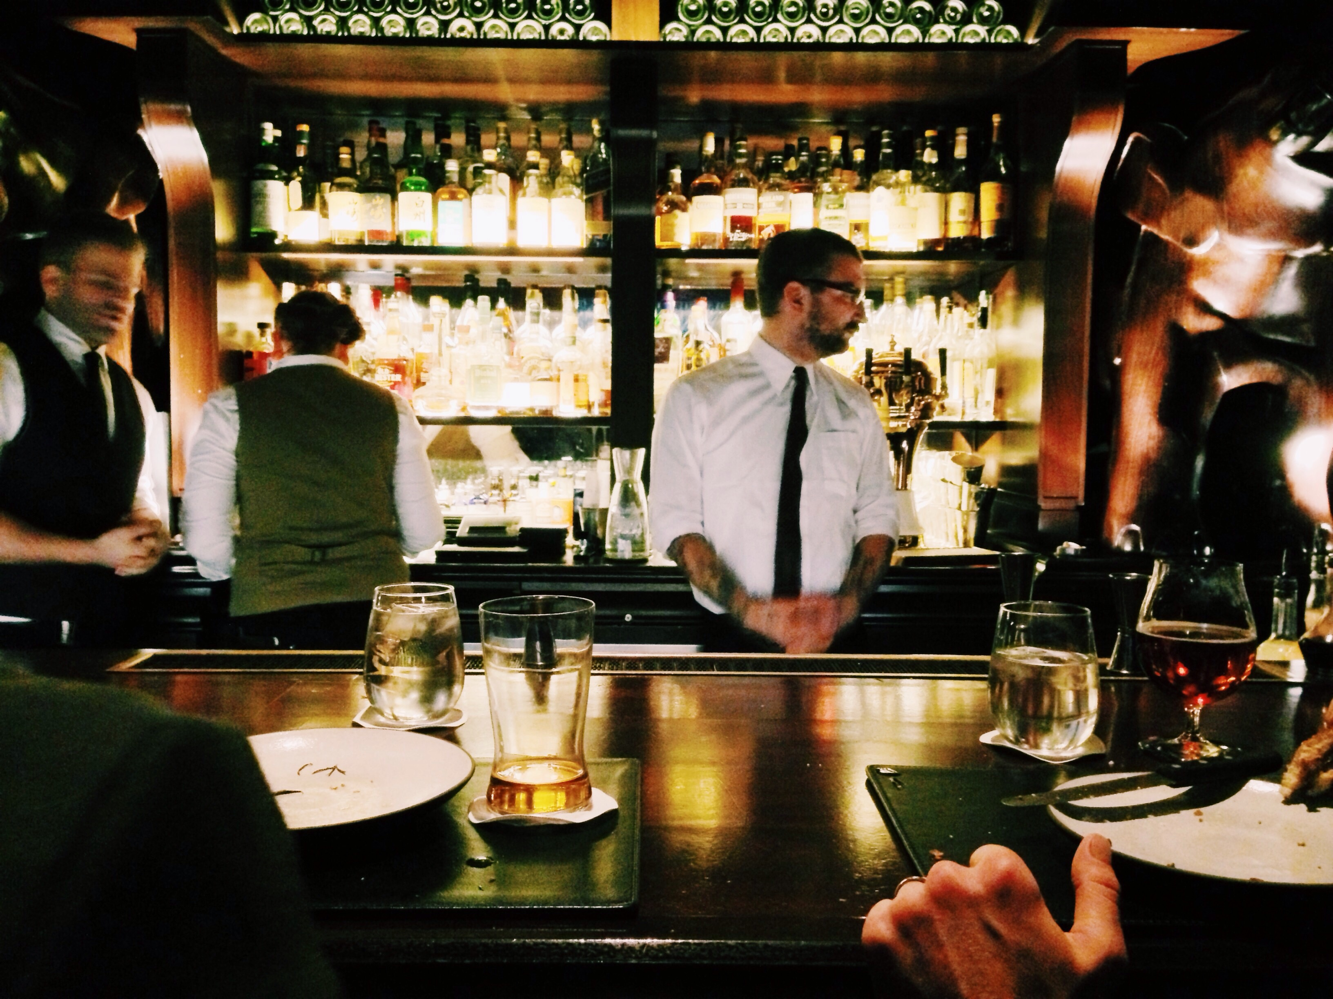
Appendix

Slide 18
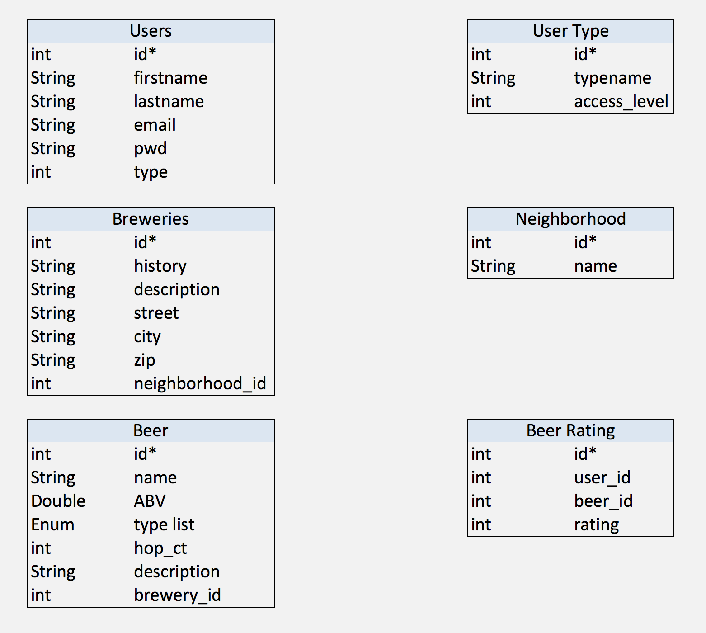
Database Schema Overview
The data is the answer

Slide 19
PENDING

